Slide 1

Russell 2000 Index Price Prediction

Slide 2
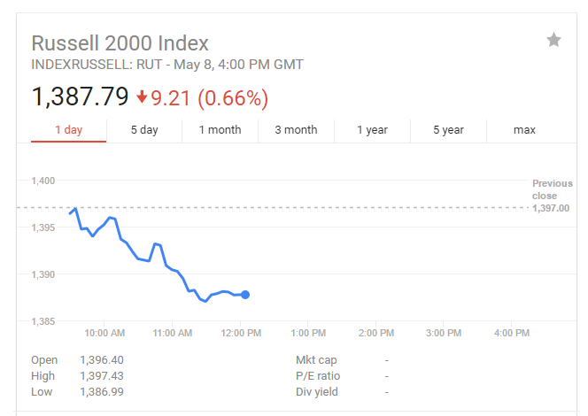
What is Russell 2000 ?
The Russell 2000 index is an index measuring the performance approximately 2,000 small-cap companies in the Russell 3000 Index, which is made up of 3,000 of the biggest U.S. stocks. The Russell 2000 serves as a benchmark for small-cap stocks in the United States. The weighted average market capitalization for companies in the Russell 2000 is about US$1.3 billion and the index itself is frequently used as a benchmark for small-cap mutual funds. [1]

Slide 3
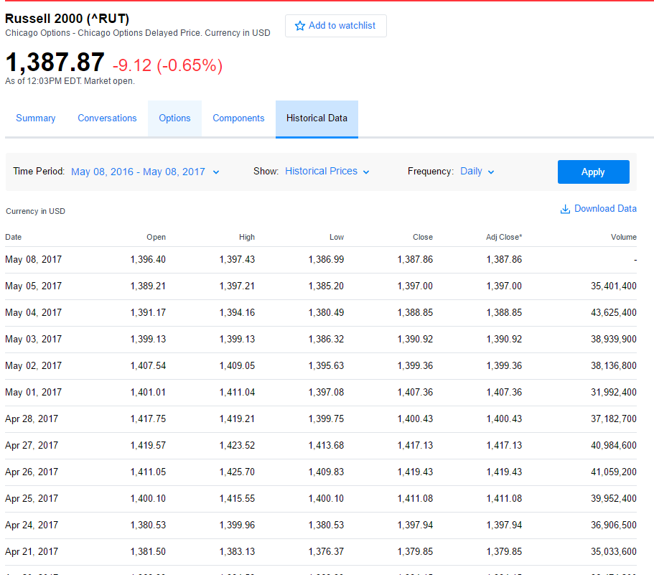
Dataset overview

Slide 4
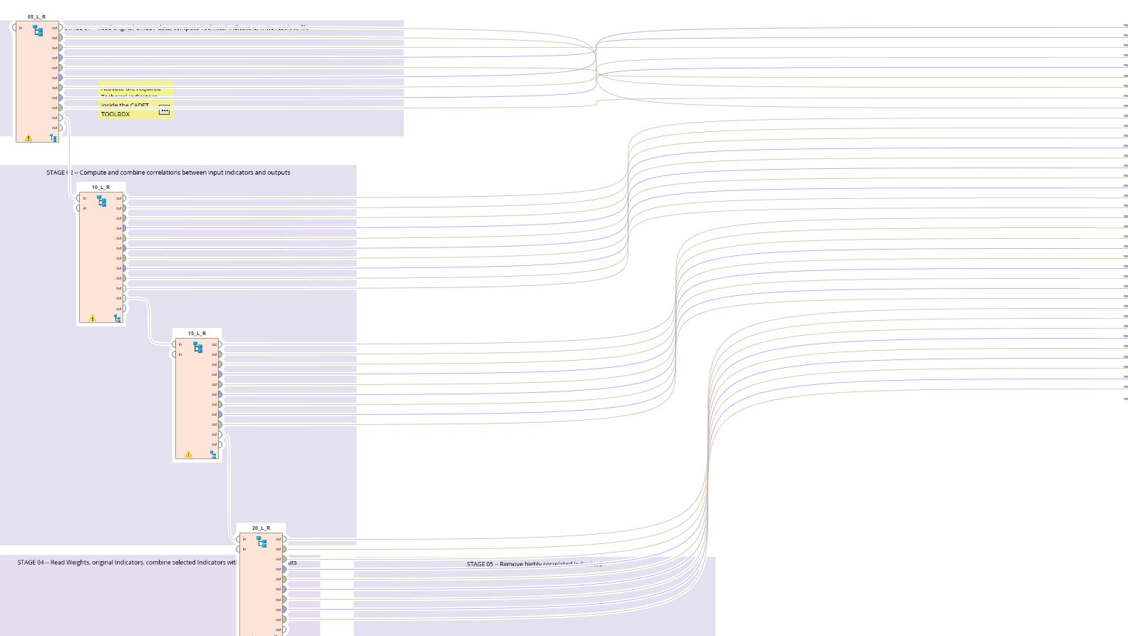
PROCESS OVERVIEW

Slide 5
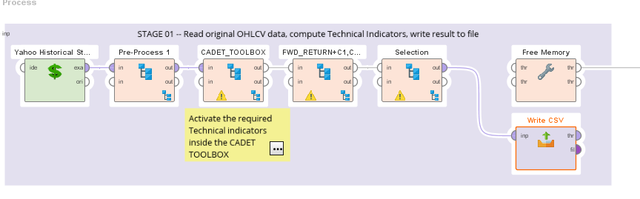
STAGE 01

Slide 6
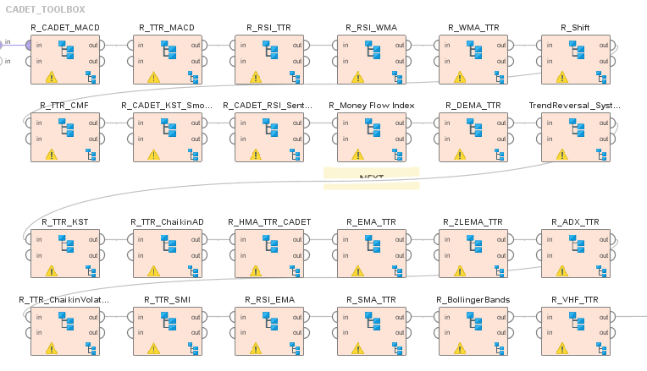
CADET TOOLBOX

Slide 7
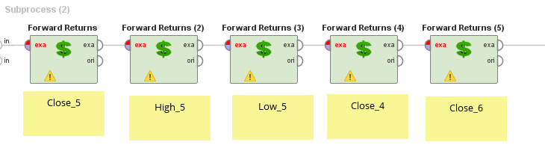
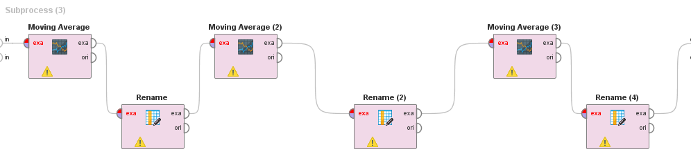
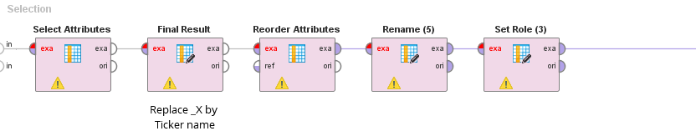

Slide 8
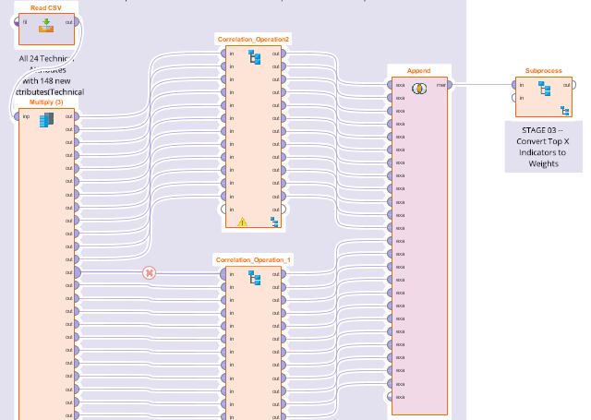
STAGE 02

Slide 9
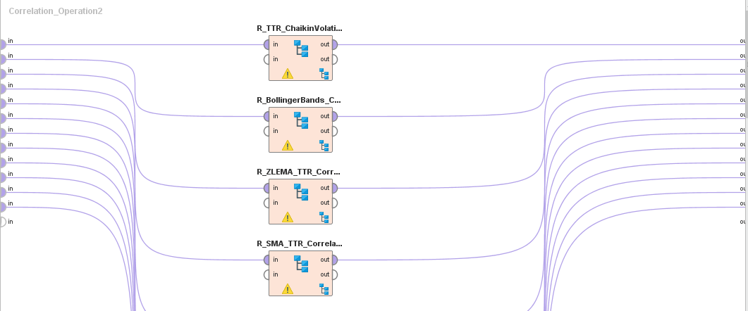
CORRELATION OVERVIEW FOR TECHNICAL OPERATORS

Slide 10
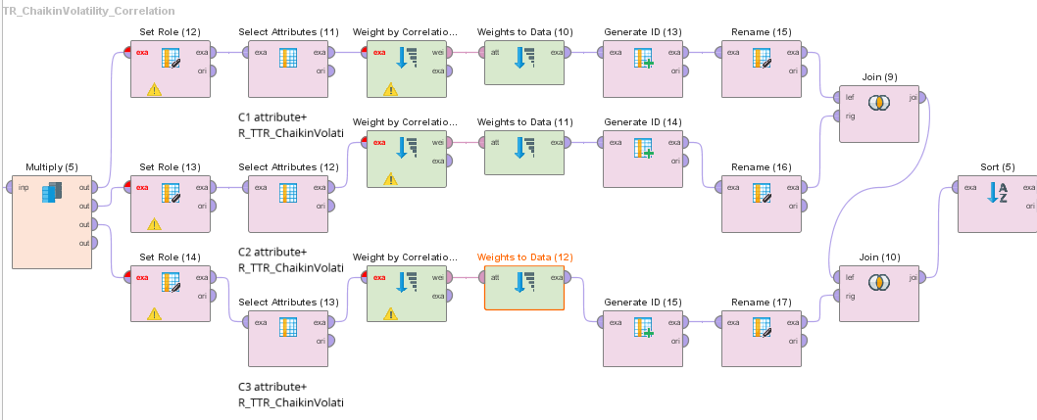
CORRELATION VIEW FOR ONE TECHNICAL OPERATOR

Slide 11
Challenge
How to convert the Obtained Weights to exampleset values?
Impute the historical data to vertical weights to horizontal dataset?

Slide 12
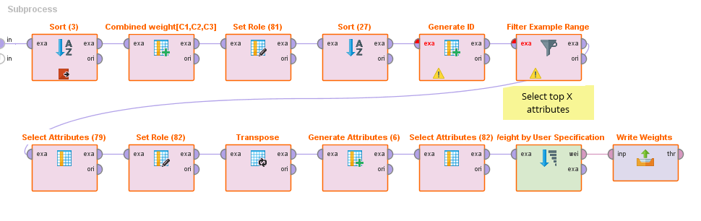
STAGE 03

Slide 13
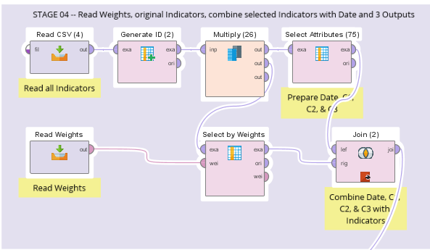
STAGE 04

Slide 14
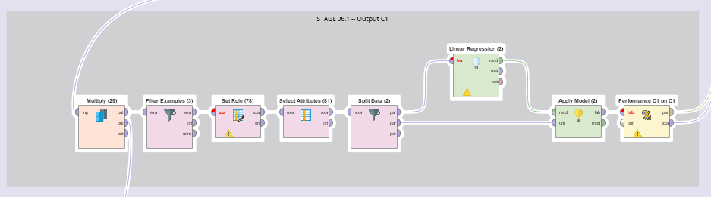
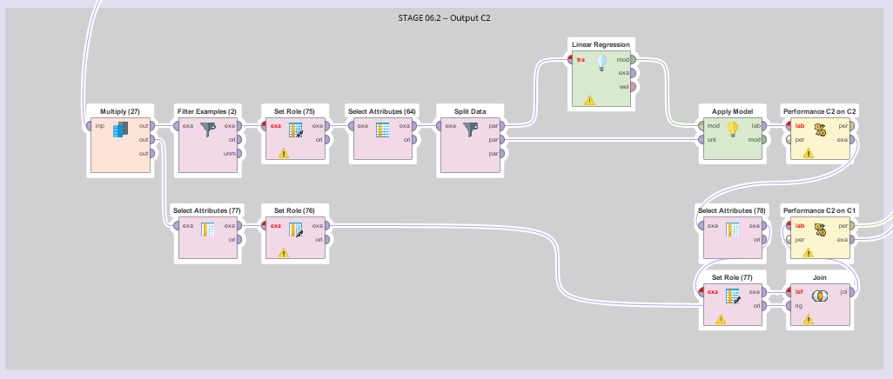
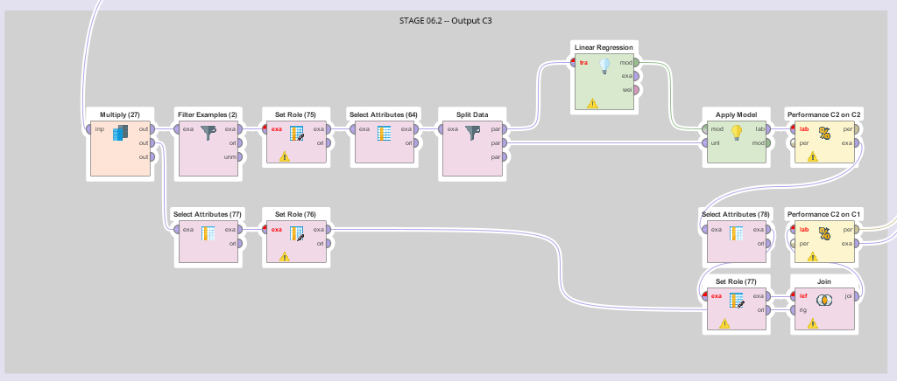

Slide 15
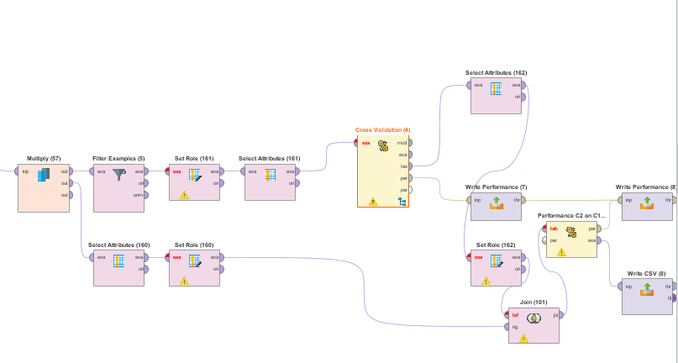
Improvised Model
X-VALIDATION FOR MACHINE LEARNER

Slide 16


RESULTS
Root Mean Squared Error (RMSE)
The square root of the mean/average of the square of all of the error.
The use of RMSE is very common and it makes an excellent general purpose error metric for numerical predictions.
Compared to the similar Mean Absolute Error, RMSE amplifies and severely punishes large errors.[4]
ABSOLUTE ERROR
The total sum of the absolute value of each individual error.[5]

Slide 17
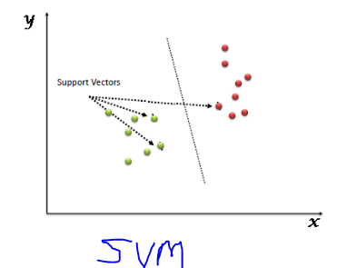
MACHINE LEARNER USED
Linear Regression involves using a linear combination of independent variables to estimate a continuous dependent variable[6]
Support Vector Machine” (SVM) is a supervised machine learning algorithm which can be used for both classification or regression challenges.[7]
A neural network acquires knowledge through learning.
A neural network's knowledge is stored within inter-neuron connection strengths known as synaptic weights.[8]

Slide 18
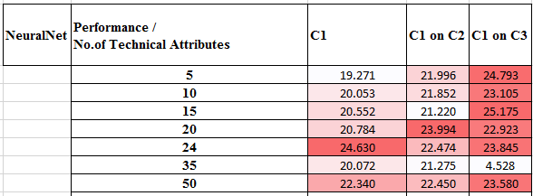
RESULTS

Slide 19
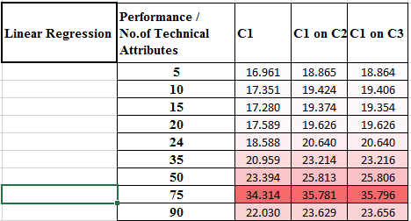

Slide 20
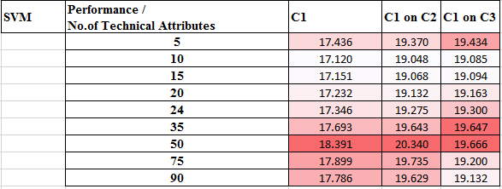

Slide 21
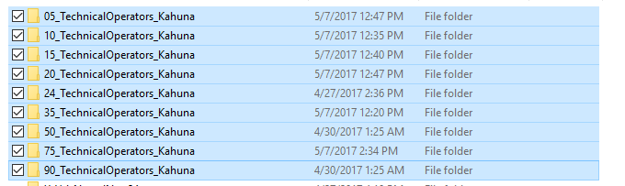
FOLDER STRUCTURE

Slide 22
Version Control and Configuration
For Data mining and Analytics Version control is not feasible for every minor tweak
So in General this Drawback in CRISP-DM can be overrated if its going to for every tweak in process model
But overall major tweaks and improvements can be moved to git repository and commits can be applied

Slide 23
Conclusion
Linear Regression and SVM machine learners are promising
RMSE value attained using these Technical operators is optimal
Neural net has certain outliers, which needed to address
Future Work
Test this model trend on other stocks
Use new error evaluation methods
Generalize the model

Slide 24
References:
http://www.investopedia.com/terms/r/russell2000.asp
http://cs229.stanford.edu/proj2013/DaiZhang-MachineLearningInStockPriceTrendForecasting.pdf
https://arxiv.org/ftp/arxiv/papers/1603/1603.00751.pdf
https://www.kaggle.com/wiki/RootMeanSquaredError
https://www.kaggle.com/wiki/AbsoluteError
https://www.kaggle.com/wiki/LinearRegression
https://www.analyticsvidhya.com/blog/2015/10/understaing-support-vector-machine-example-code/
http://www.neurosolutions.com/products/ns/whatisNN.html

